Slide 1
Zero to ONE

Slide 2
Hi, I’m Rich

Slide 5
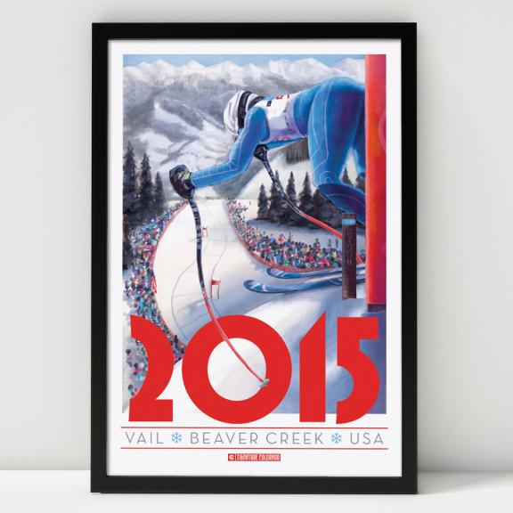
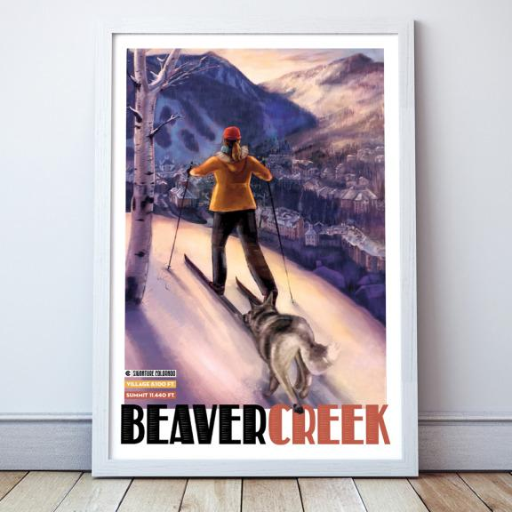

Slide 6
Background

Slide 7
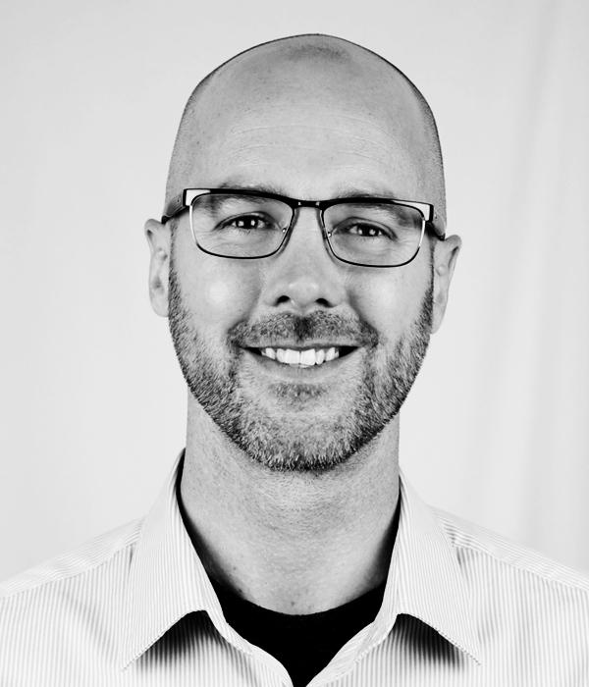
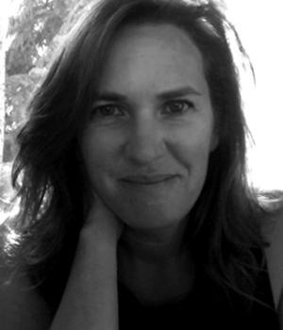
Team
Aaron Cessna
Creative Direction
Dawn Beacon
Illustrator

Slide 8
Relationships are built years in advance.

Slide 9
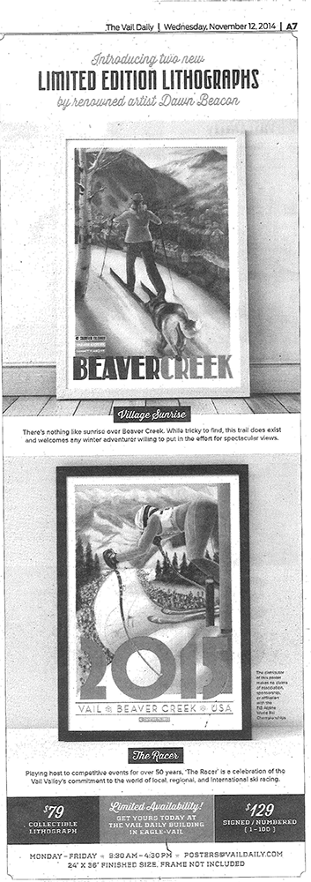
Relationships are built years in advance.
Vail Daily
Helped us connect with their printer in Denver
Daily ad to promote walk-in sales
Facilitated wholesale distribution to their vendors

Slide 10
2. Start with the end in mind, and work backwards to define step 1

Slide 11
2. Start with the end in mind, and work backwards to define step 1
Product / Market Fit (Validation)
Minimum Viable Product
Roadmap
Financial Milestones
Customer Lifetime Value Goals
Scale / Efficiency / Detachment
Partnerships
Marketplace
Fulfillment

Slide 12
3. Start collecting customer and lead data immediately.

Slide 13
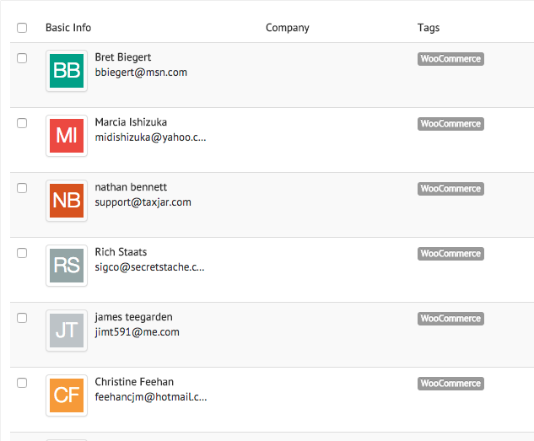
3. Start collecting customer and lead data immediately.
Email List
Facebook Retargeting Pixel
CRM

Slide 14
4. Define your sales opportunities, and then decide how to market to each specific channel

Slide 15
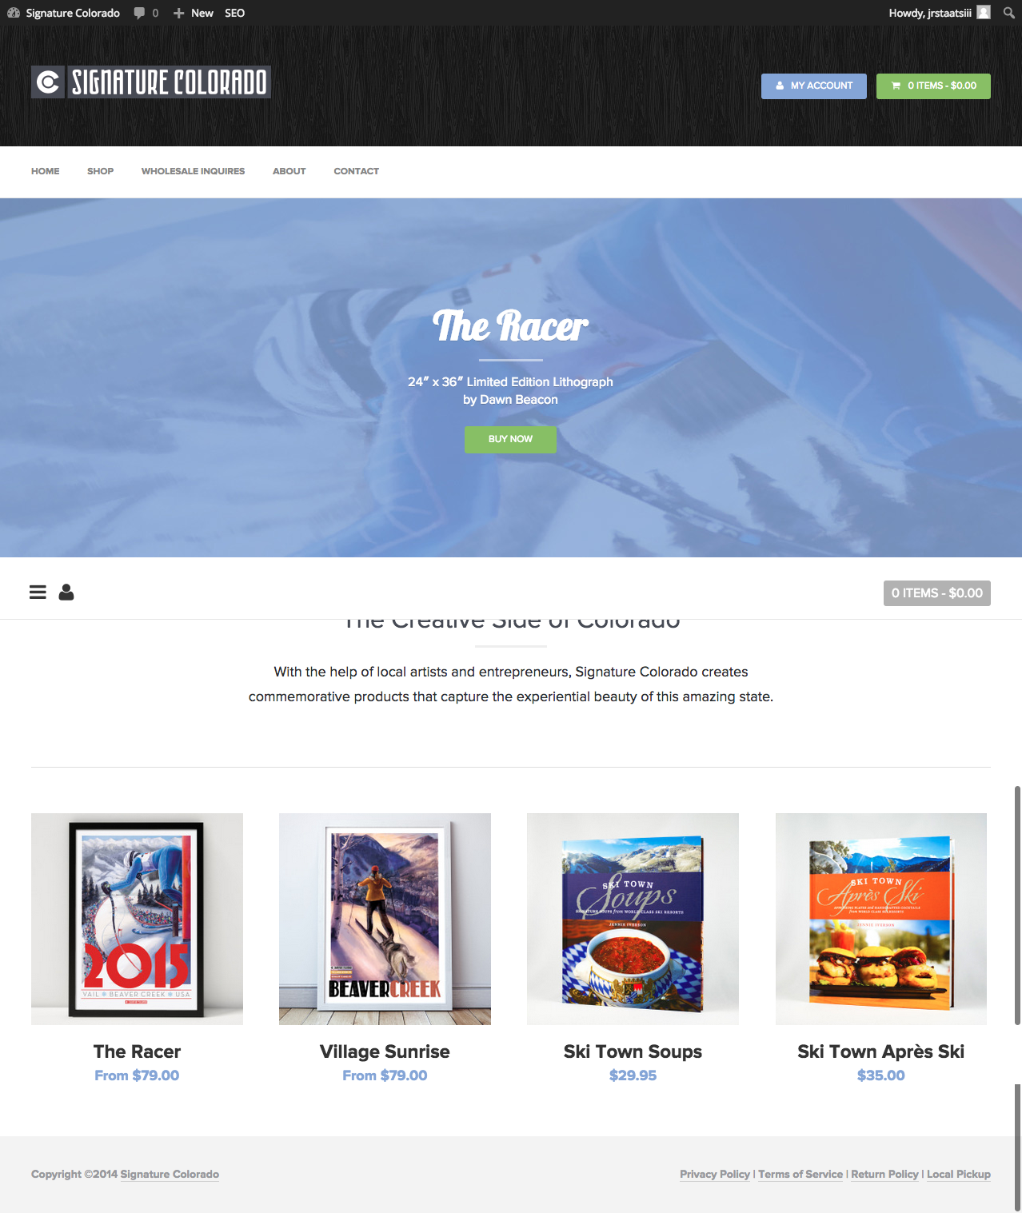
4. Define your sales opportunities, and then decide how to market for these specific channels
Wholesale
Online Retail
Vin48 Art Showcase
Apres Avon
Next: Farmers Markets

Slide 16
5. Do things that don’t scale

Slide 17
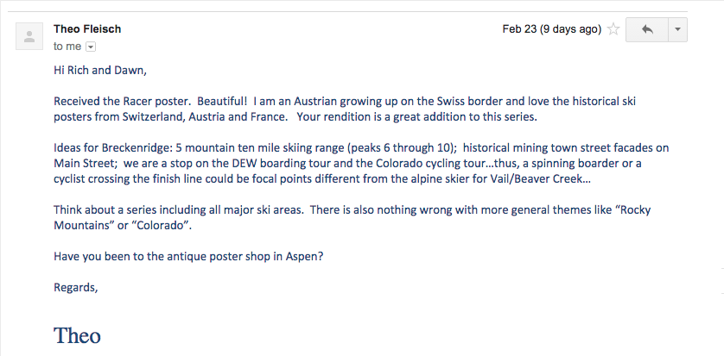
5. Do things that don’t scale
For Customers:
asked customers what number they wanted
scheduled followup 3 weeks after purchase.
For Vendors:
rolled wholesale orders at cost of tube
quality assurance
marketing promotion inside

Slide 18
6. Process is Greater than Practice

Slide 19
6. Process is Greater than Practice
Document everything in such a way that it can be passed off to someone else. Your goal is to extract yourself from day to day tasks as soon as possible
Series Deliverables
How to roll posters without damaging them
Notes:
The goal is NOT to become the best at rolling posters, it’s to figure out the best way, and define the steps and tools so others can become better than you.

Slide 20
7. Become meticulous with regard to your time

Slide 21
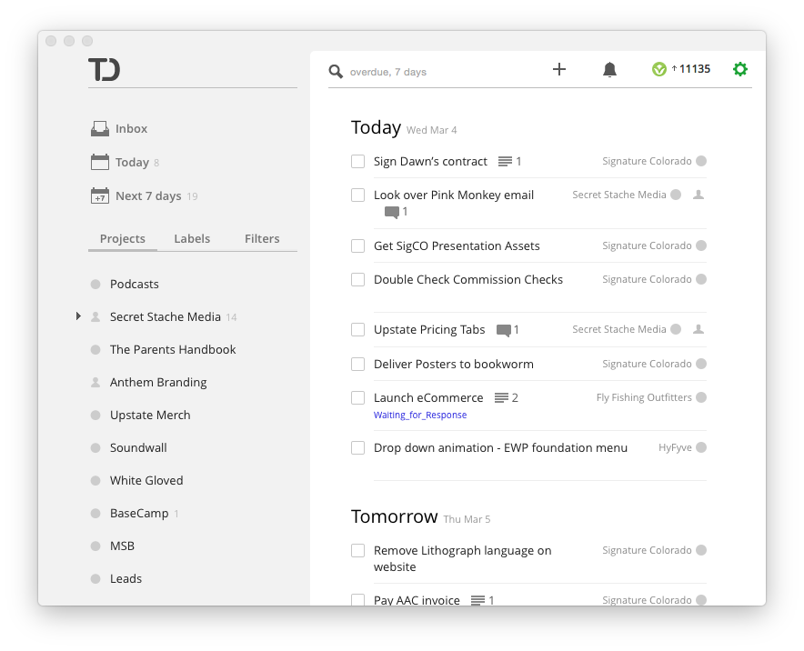
7. Become meticulous with regard to your time
Plan each day the night before
Do the hardest tasks first, in the morning if possible
Find a calendar tool you like and use it religiously
Find a todo list app with an api, and become a power user.
Set daily goals, and give yourself permission to relax if you reach them

Slide 22
8. Become meticulous with regard to your finances

Slide 23
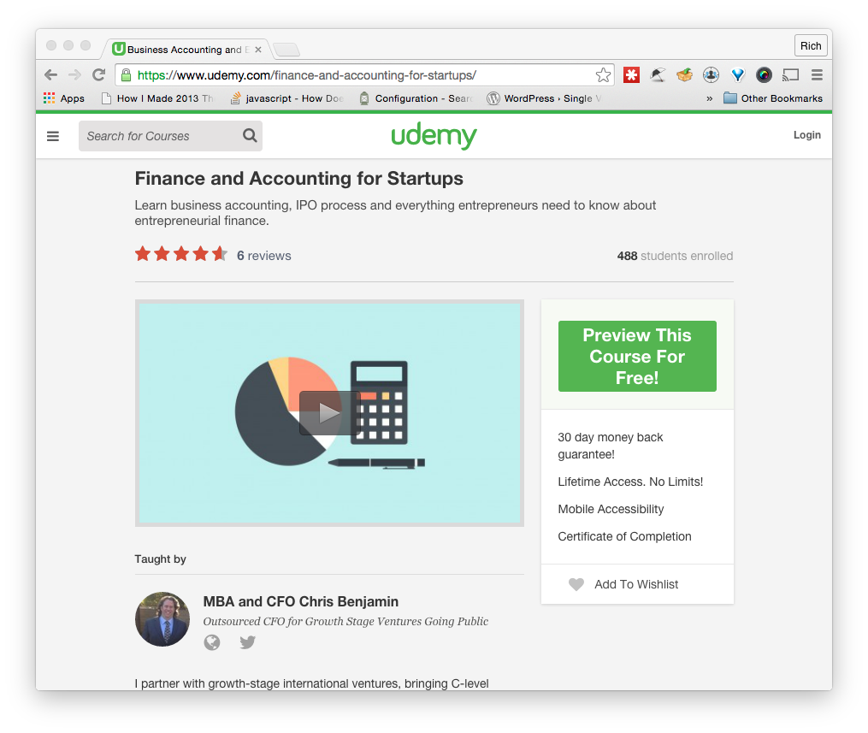
8. Become meticulous with regard to your finances
Online Courses (Udemy, Lynda)
CMC - 2 Day Account Workshop
As soon as possible, hire a bookkeeper

Slide 24
9. Become obsessed with your health

Slide 25
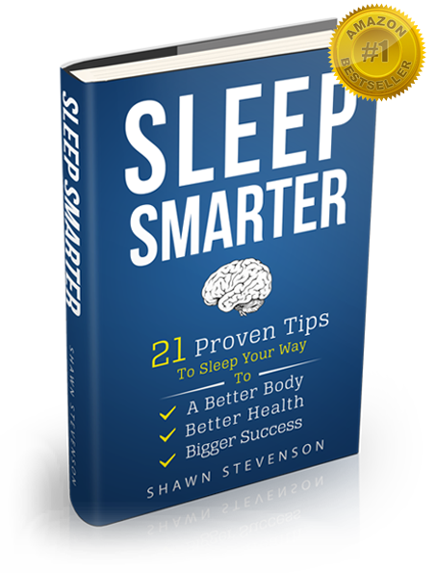
9. Become obsessed with your health
Learn how to get the best sleep you can, especially if you aren’t getting enough of it.
Schedule exercise every day. This should be as much of a mental challenge as it is a physical challenge
The Shawn Stevenson Model Podcast
Door to Door Organics

Slide 26
10. Be in control of the sacrifices you make
...because they are being made one way or another

Slide 27
In Retrospect
A few things we learned the hard way

Slide 28
In Retrospect
Framed art is expensive, hard to sell, and even harder to accommodate for shipping.
Printed marketing / mailers should be as generic as possible with the intention of reuse.
Technically, the product cannot be classified as a “lithograph” as “lithographs” are created individually, and by hand.
Transporting loose packs of posters is a huge pain in the ass, especially in the winter
You need proper storage for loose posters
Rolling heavyweight posters is harder than it looks

Slide 29
Thank you

